Slide 1
Increasing Statewide Participation
Notes:
Good afternoon everyone. My name is Ian Irizarry and it is my pleasure to present my findings on increasing statewide participation for the College Board’s SAT program.

Slide 2
Notes:
Before I present the findings of our study, I want you to think about the two major brands: pepsi and coca-cola. Both companies have staunch supporters.
To switch sides is blasphemy. In fact, even many of you might think twice before drinking one or the other.
What makes this so interesting, however, is that a 2004 study done on taste preferences demonstrated that when given to participants blindly, most couldn’t tell the difference. (https://daily.jstor.org/the-coca-cola-wars-can-anybody-really-tell-the-difference/)
That means it’s all about brand loyalty.
Now what does this have to do with increasing participation rates?

Slide 3
1. Background
2. Findings
3. Recommendations
Notes:
Before I answer that last question, I want to do a quick overview of “why” this participation study even happened.
I’m going to give a quick overview of how we got here
Then I’ll go over my findings
Then Ill give a recommendation and an answer to the question of why brand matters

Slide 4
March 2016, New SAT format
College Board task force
Tracking Participation
Provide a recommendation for increasing participation rates
Notes:
So the task force was established after the roll out of the new SAT format in March of 2016.
The College Board selected a group of us to track participation overtime and then to provide a recommendation for increasing the participation rate in select states
But what inspired this task force?

Slide 5





ACT passes SAT global participation
SAT passes ACT global participation
1996
2016
2012
2018
SAT is considered the go to Standardized test
SAT change format
Notes:
https://www.washingtonpost.com/education/2018/10/23/sat-reclaims-title-most-widely-used-college-admission-test/
In 1996, the SAT was considered the king of the standardized test. But then, something happened. In 2012, the ACT overtook that title and passed the SAT in global participation rates. It remained this way for awhile.
So in March 2016, we decided to roll out a new format which was the result of receiving numerous complaints on the difficulty of the vocabulary on the test.
Then, in 2018, we found that our participation rates exceeded the ACT.
This is great news, but, it poses a lot of questions. The most important being: what influences the participation rate?

Slide 6
Findings
Notes:
This brings us to our findings.

Slide 7
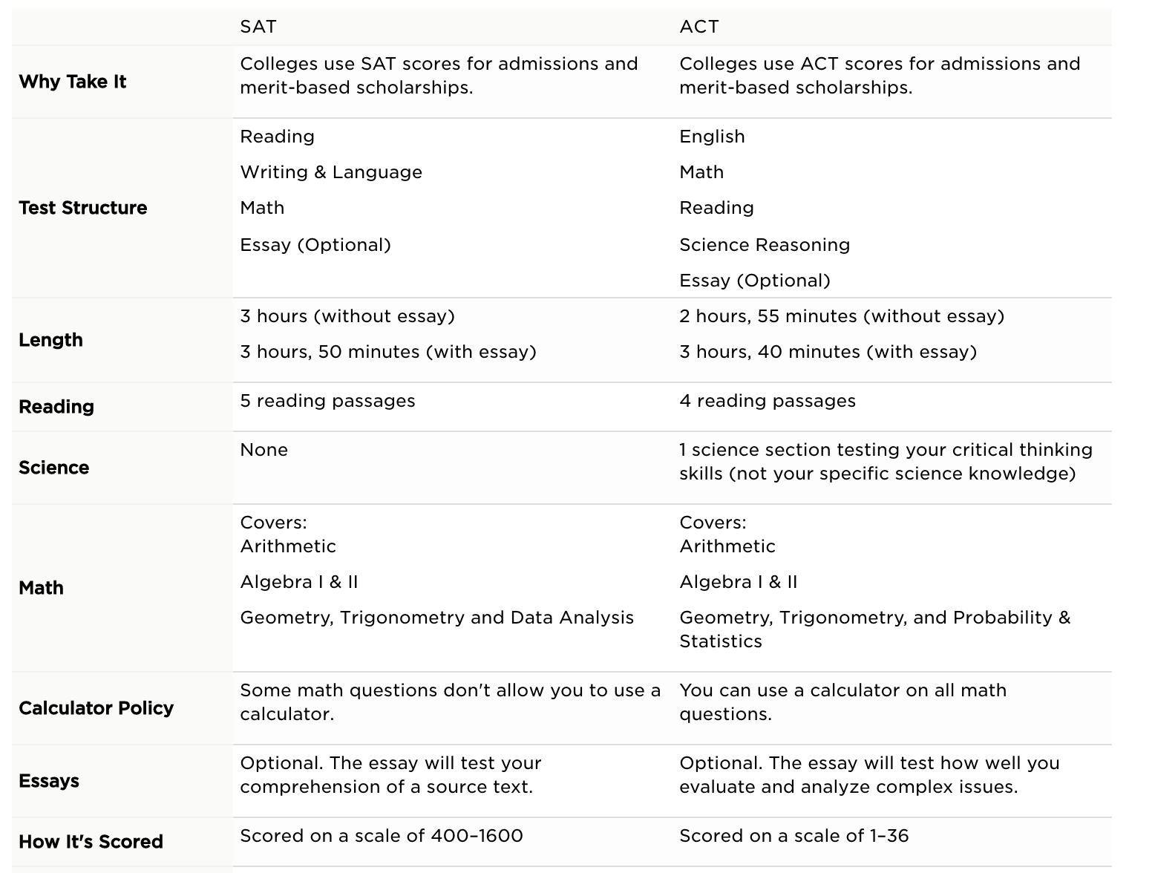
Notes:
https://www.princetonreview.com/college/sat-act
First, I’d like to demonstrate a quick side by side of the test. As you can see, there are some differences but you could argue that they are very similar. That’s why they are competitors.

Slide 8
Lowest Participation Rate States
States with Lowest Participation Rates | SAT Participation Rate | ACT Participation Rate
North Dakota (2017) | 2% | 98%
Mississippi (2017) | 2% | 100%
Iowa (2017) | 2% | 67%
Missouri (2017) | 3% | 100%
Utah (2017) | 3% | 100%
North Dakota (2018) | 2% | 98%
Wyoming (2018) | 3% | 100%
South Dakota (2018) | 3% | 80%
Nebraska (2018) | 3% | 84%
Wisconsin (2018) | 3% | 100%
Notes:
https://www.edweek.org/ew/section/multimedia/states-require-students-take-sat-or-act.html – 2018-2019
North Dakota – students must take the ACT or other test (non-SAT)
Mississippi – ACT is required or pass other test (non-SAT)
Iowa – No requirement
Yet, despite the closeness of the tests, you can see there are quite a few states with preferences. Here you see a list of states that prefer the ACT

Slide 9
Highest Participation Rate States
States with Lowest Participation Rates | SAT Participation Rate | ACT Participation Rate
District of Columbia (2017) | 100% | 32%
Michigan (2017) | 100% | 29%
Connecticut (2017) | 100% | 31%
Delaware (2017) | 100% | 18%
New Hampshire (2017) | 96% | 18%
Connecticut (2018) | 100% | 31%
Delaware (2018) | 100% | 18%
Michigan (2018) | 100% | 29%
Idaho (2018) | 100% | 38%
Notes:
https://www.edweek.org/ew/section/multimedia/states-require-students-take-sat-or-act.html – 2018/2019
District of Columbia – SAT or other test required (non-ACT)
Michigan - allows for both tests or other test required
Connecticut – SAT required
Here you see a list of states that prefer the SAT.
Now you may have noticed something. When one state prefers one test, the other test suffers in participation rate. We call this a negative correlation.

Slide 10
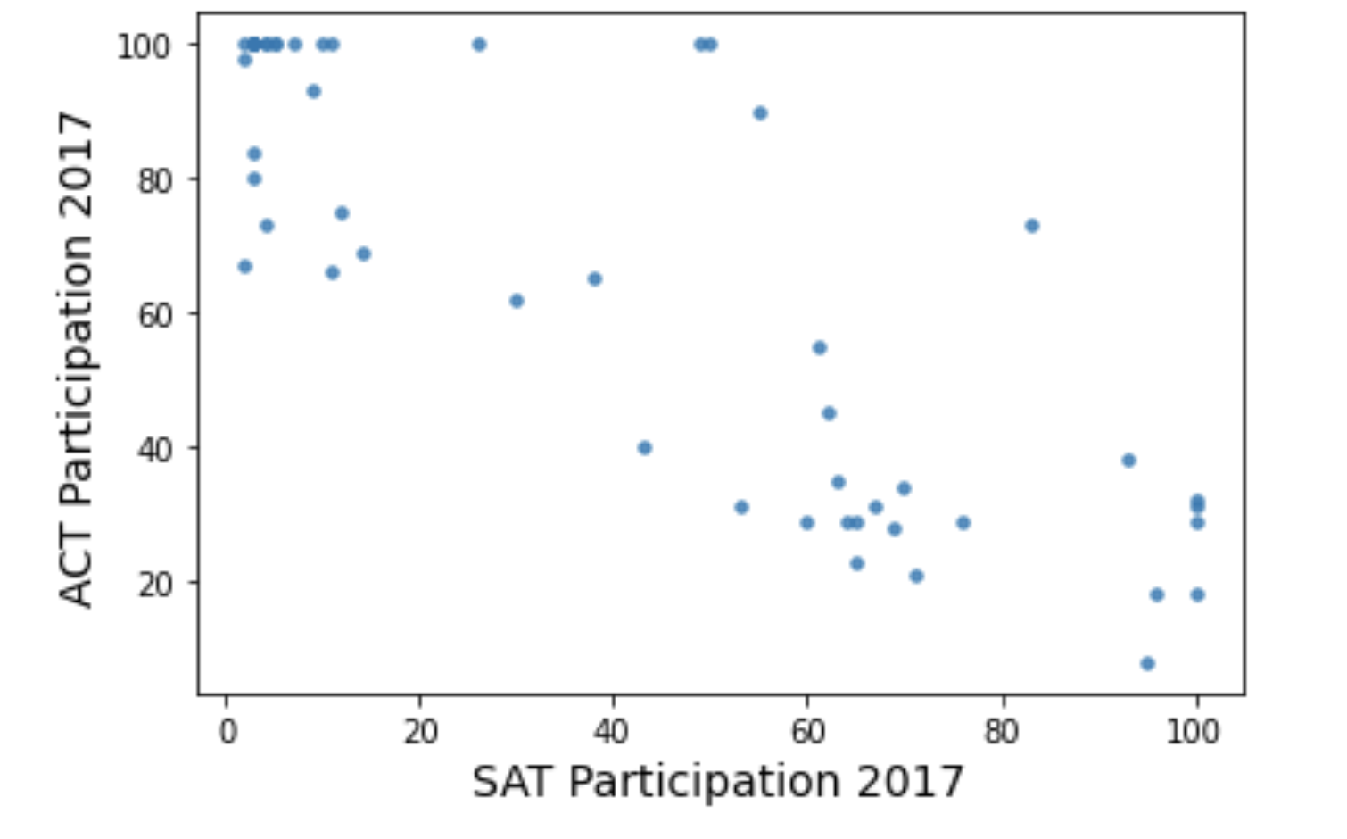
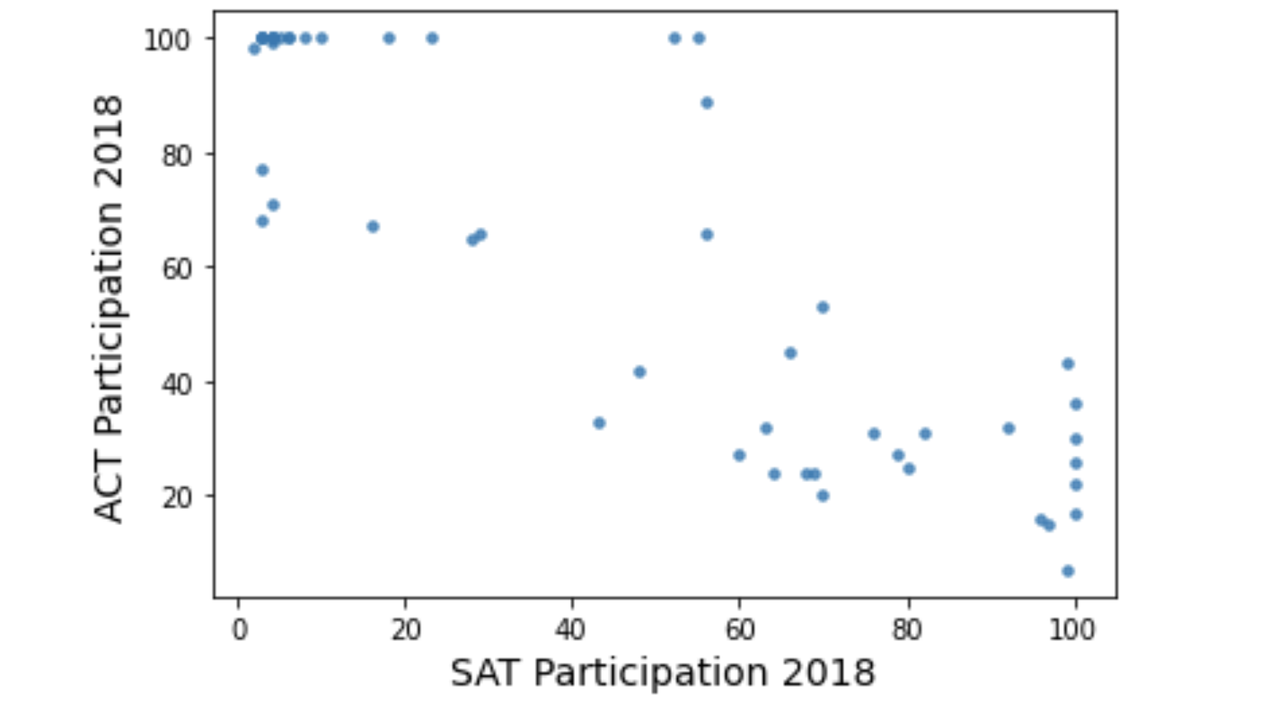
Trends
Notes:
That’s what you are seeing here. A negative correlation. As one test receives high participation, the other suffers. You also see, that it’s consistant from year to year.

Slide 11
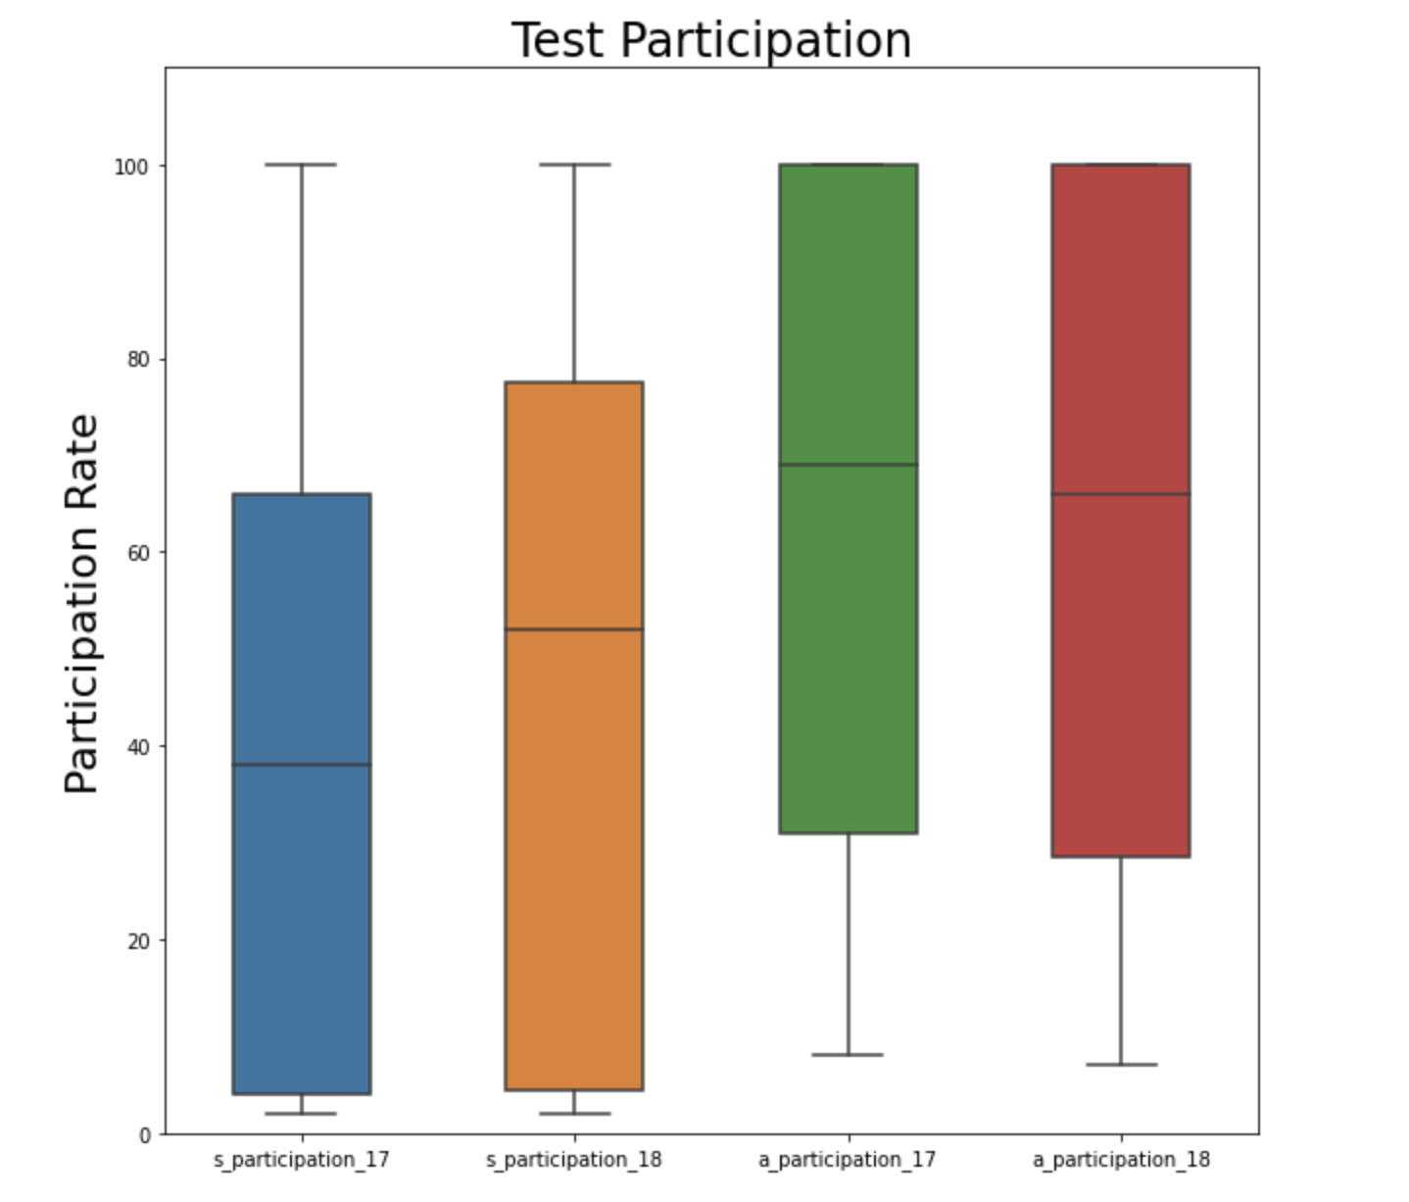

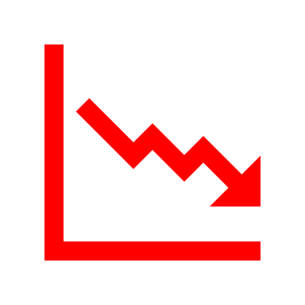
Remember
If SAT
Then ACT
=
=
Notes:
Here we can see it another way. The blue and orange box represent the SAT. The green and red represent the ACT. The black lines in the boxes represent median participation rates. This just means the middle of the data. What we want to see is median rates increasing. And in fact, we do. As the SAT increased in participation rates, the ACT decreased. But what caused this increase?

Slide 12
Notes:
https://www.chicagotribune.com/news/breaking/ct-met-illinois-act-test-scores-20181016-story.html
The State of Illinois has been home of the ACT for a long time. But something happened.

Slide 13
ACT 2017
ACT 2018
43%
93%
SAT 2017
SAT 2018
9%
99%
Notes:
You can see here that participation rates in 2017 for the ACT were really high

Slide 14
Why the Sudden Change?

Slide 15
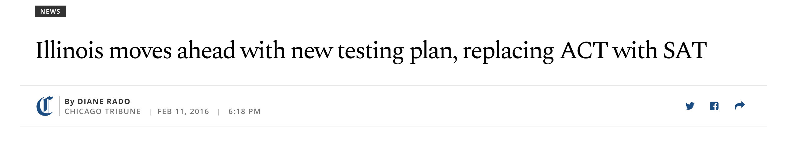
Notes:
https://www.chicagotribune.com/news/ct-illinois-chooses-sat-met-20160211-story.html
The ACT has been the go-to in Illinois for years.
The SAT won a 3-year contract to give exams to all public high-school juniors in 2016
Many schools had already signed up for the ACT for 2017 - at their expense

Slide 16


Recommendations
Notes:
So there are a lot more questions that could probably be answered. For example, what other influences outside of legislative change affect participation rates.
So back to my question of how brand influences.
Illinois took a little while to switch from ACT to SAT. Districts even paid out of pocket to stay with ACT. In fact, it took 3 years for the SAT to increase.
Therefore, one could speculate that preferences have an impact. This brings us back to our pepsi and coke example.

Slide 17

What we know:
When SAT increases, ACT decreases
When States adjust testing requirements, it is influential
Preferences die hard
Notes:
https://www.nytimes.com/article/sat-act-test-optional-colleges-coronavirus.html – More colleges are waiving SAT and ACT requirements
https://www.psychologytoday.com/us/blog/creative-development/201912/new-trend-test-optional-sats-and-acts-may-not-be-required – support for eliminating requirements is growing
https://www.testive.com/colorado-sat-change-2017/ - Colorado switched from the ACT to the SAT

Slide 18
Three Recommendations
Map out which states have requirements, and which do not
Develop a branding message that demonstrates why they should choose the SAT
Target state requirements
Notes:
https://www.psychologytoday.com/us/blog/creative-development/201912/new-trend-test-optional-sats-and-acts-may-not-be-required – prepare for the option that requirements will no longer exist.

Slide 19
Q & A

